Slide 1
BERT and Friends
CS 780/880 Natural Language Processing Lecture 20
Samuel Carton, University of New Hampshire

Slide 2

Last lecture
Transformer architecture
Many layers
Self-attention
Feed-forward
Residuals
Encoder-decoder
Encoder nonrecurrent
Decoder recurrent
Positional encodings
Pretrained transformer (BERT) is a good starting point for fine-tuning!

Slide 3
Last lecture
Transformer architecture
Many layers
Self-attention
Feed-forward
Residuals
Encoder-decoder
Encoder nonrecurrent
Decoder recurrent
Positional encodings
Pretrained transformer is a good starting point for fine-tuning!

Slide 4
Pretrained transformers
Every current well-known large language model is a transformer that has been extensively pretrained on a large corpus of text, with some language modeling objective
BERT, RoBERTa, T5, GPT-X, etc.
The difference between different models is mostly just:
Training objective
Use of encoder only, decoder only, or both
Model size
Training set size & composition
Dataset preprocessing
Minor architecture differences
…which seems like a lot, but it’s still pretty remarkable that the underlying model is mostly the same (Transformer)

Slide 5
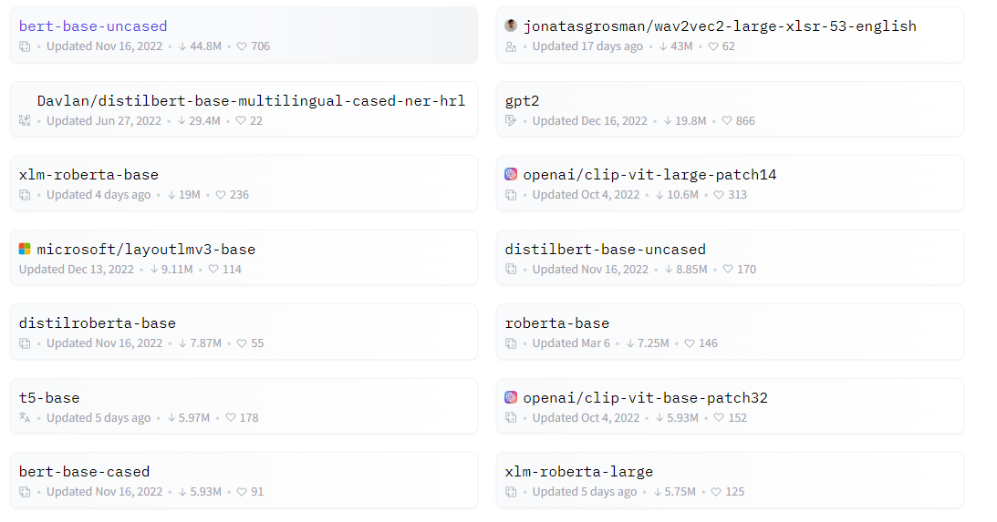
Well-known models
There’s a few key models that are in wide use:
BERT
RoBERTa
XLNet
DistilBERT
T5
GPT family
Most can be downloaded at https://huggingface.co/models

Slide 6
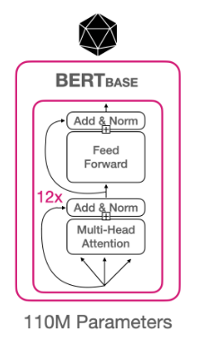
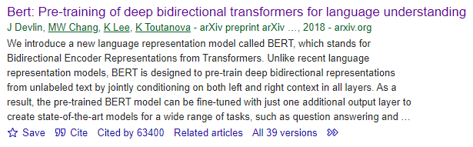
BERT
Bidirectional Encoder Representations from Transformers
Encoder-only model
Bert-base:
12 layers, 12 heads per layer
110 million parameters
Two pretraining objectives:
Masked language modeling (Mask-LM)
Next sentence prediction (NSP)

Slide 7
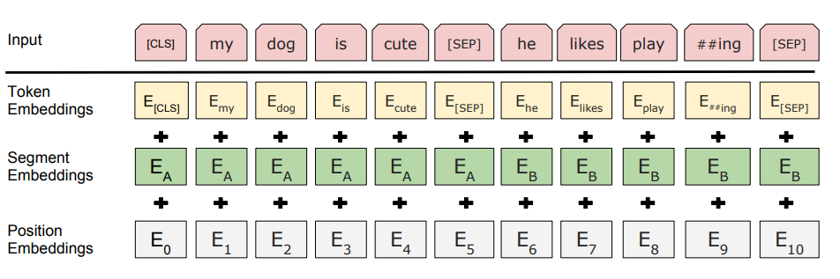
BERT encoder
The BERT encoder:
Takes in wordpieces
With [CLS] at the beginning and [SEP] between sentences
Adds positional and segment ID (0 or 1) embeddings
Outputs a hidden state vector for each wordpiece (including [CLS] and [SEP]s)

Slide 8
BERT encoder
The BERT encoder:
Takes in wordpieces
With [CLS] at the beginning and [SEP] between sentences
Adds positional and segment ID (0 or 1) embeddings
Outputs a hidden state vector for each wordpiece (including [CLS] and [SEP]s)
Output
H_{[CLS]}
H_{my}
H_{dog}
H_{is}
H_{cute}
H_{[SEP]}
H_{he}
H_{likes}
H_{play}
H_{ing}
H_{[SEP]}
BERT encoder

Slide 9
BERT pretraining
Mask-LM: Randomly mask 15% of tokens and try to predict them from H_{token}
NSP: Randomly sample correct/incorrect sentence pairs, try to predict which is correct from H_{[CLS]}
A term used for this overall approach is denoising autoencoding
“Denoising” because it tries to correct missing tokens
“Autoencoding” because it tries to encode unlabeled text to a vector representation
Pretraining corpus:
BooksCorpus (800M words)
English Wikipedia (2,500M words)
BERT_{LARGE} is also available (24 layers, 16 heads per layer, 340M params)

Slide 10
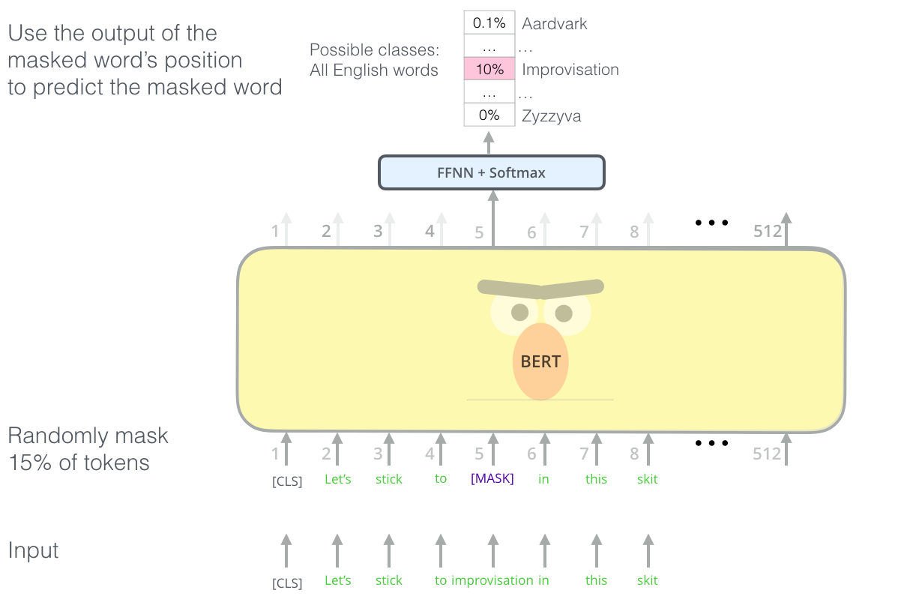
Masked language modeling
https://jalammar.github.io/illustrated-bert/

Slide 11
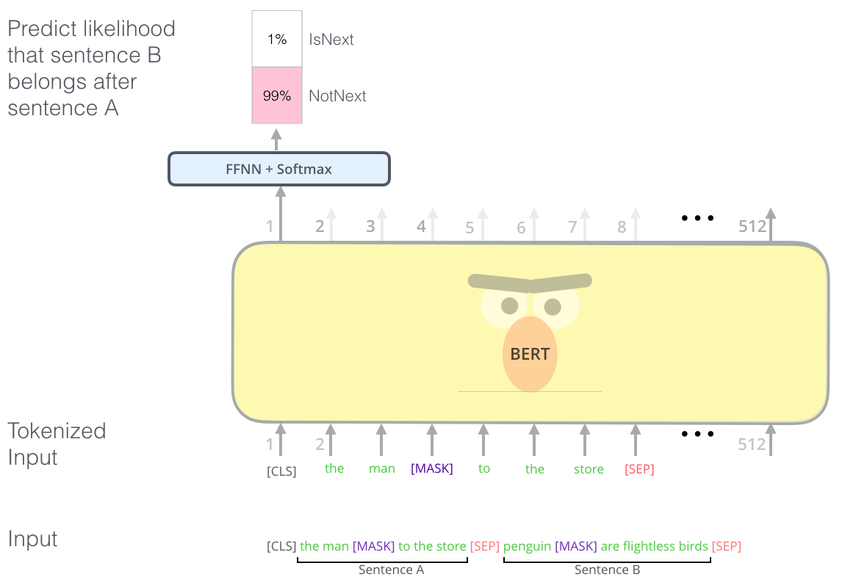
Next-sentence prediction
https://jalammar.github.io/illustrated-bert/

Slide 12
Deep contextualized representations
A key thing about these models is that they produce deep contextualized representations of their input
A single vector that represents the whole sequence (H_{[CLS]}) or an individual token (H_{token})
The vector reflects the context surrounding that token.
So H_{jerk} will be different for “You are a jerk.” versus “I like jerk chicken”
Compare and contrast to word vectors
With large scale pretraining, we have models which can produce useful representations of input, which we can then fine-tune to do specific things
Kind of like teaching someone English before trying to teach them to grade papers

Slide 13
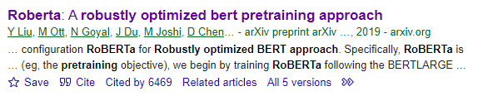
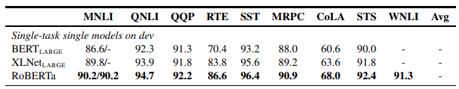
RoBERTa
Essentially a refinement/exploration of BERT
Same architecture & training data
Also encoder-only
Ditches NSP
Does “dynamic” mask-LM
Improved performance on NLP benchmarks
Comparable size to BERT_{LARGE}
24 layers, 16 heads per layer, 355M params total
Probably a better default choice than BERT, if you have the GPU memory

Slide 14
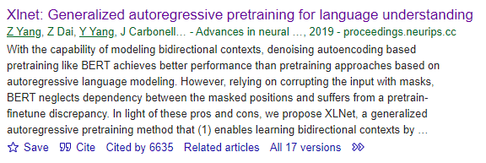
XLNet
Another competitor of BERT that occasionally shows up in the literature
Also uses only the encoder
Pretrains using a variant of autoregressive language modeling called permutation language modeling
Comparison with BERT
Same size
Additional training data:
ClueWeb
Common Crawl
Broadly improved performance

Slide 15
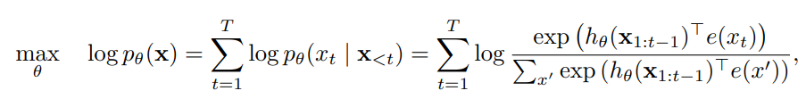
Autoregressive language modeling
Basic idea: train the model to be most likely to reproduce the training data
We’ve learned this before (a couple times), but this is alternative terminology.
Based on a forward factorization of the text where each x_{t} is dependent on {x₀…x_{t-1}}, so we can factorize the overall likeliness of x as a sum of log-probabilities of each individual x_{t}:
Several options for exactly how to do this:
Teacher forcing: each x_{<t} is drawn from the true data
Naïve autoregression: each x_{<t} is the one generated by the model

Slide 16
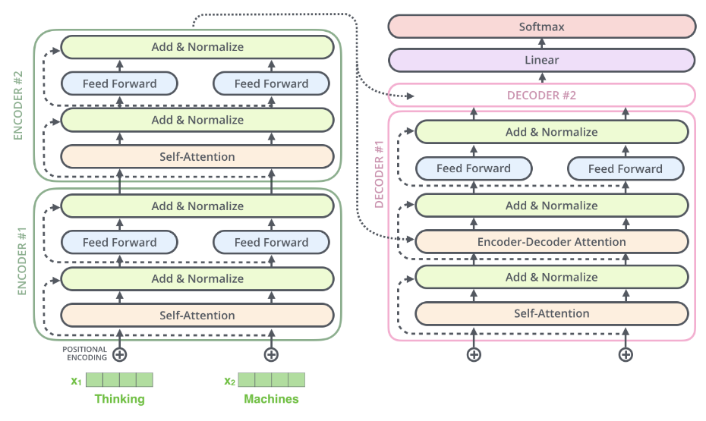
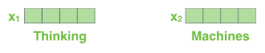
Autoregressive language modeling

Slide 17

Autoregressive decoding

Slide 18
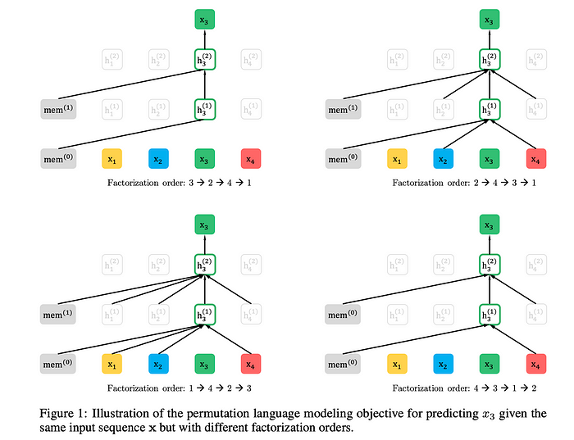
XLNET: Permutation language modeling
Rather than only optimizing for token likelihood in forward factorization, XLNet optimizes for every possible permutation of the text
So not just P(X₃ | X₁, X₂), but also P(X₃), P(X₃|X₄), P(X₃|X₁, X₄, X₂), etc..
But doesn’t use decoder!
Instead manipulates model attention and positional encodings to erase and reorder tokens from input

Slide 19
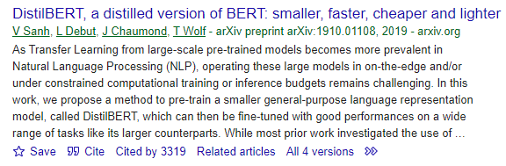
DistilBERT
A version of BERT that has been reduced in size from BERT by a process called knowledge distillation
Knowledge distillation:
Big (trained) teacher model and small student model
Train student model to emulate teacher model
Different from regular training because teacher model produces nonzero probabilities over other possible classes, which is richer training data than 1’s and 0’s
Kind of like explaining that a shape in a CT scan is a tumor, but also looks like a cyst, rather than “it’s just a tumor and not a cyst”
97% of the performance of BERT, but 40% smaller and 60% faster
6 layers, 12 heads per layer, 66M parameters

Slide 20
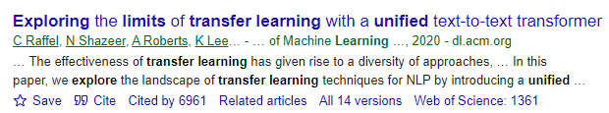
T5
Important model. Really the first big improvement from the BERT variants.
Uses the full encoder-decoder apparatus of the Transformer architecture
Does a combination of unsupervised language modeling and supervised text-to-text modeling
Fine-tuned T5 is still pretty close to SoTA for many NLP tasks

Slide 21
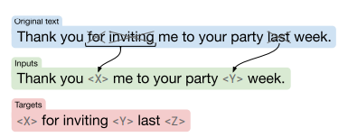
T5 pretraining—unsupervised
Creates a big, cleaned-up unsupervised training corpus:
“Colossal Clean Crawled Corpus”: cleaned-up version of Common Crawl
Uses variant of masked-LM objective from BERT, mapping corrupted text to true text
Can mask out contiguous sequences of tokens at once
Uses teacher-forcing to train decoder

Slide 22
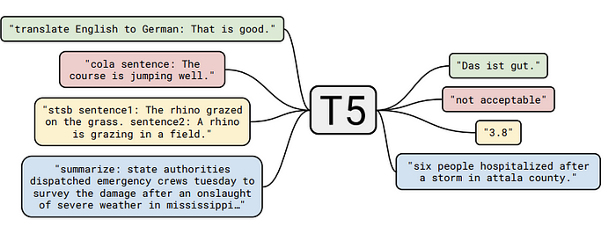
T5 pretraining—supervised
Also converts a diverse set of supervised learning datasets into text-to-text tasks, and trains on them
GLUE and SuperGLUE

Slide 23
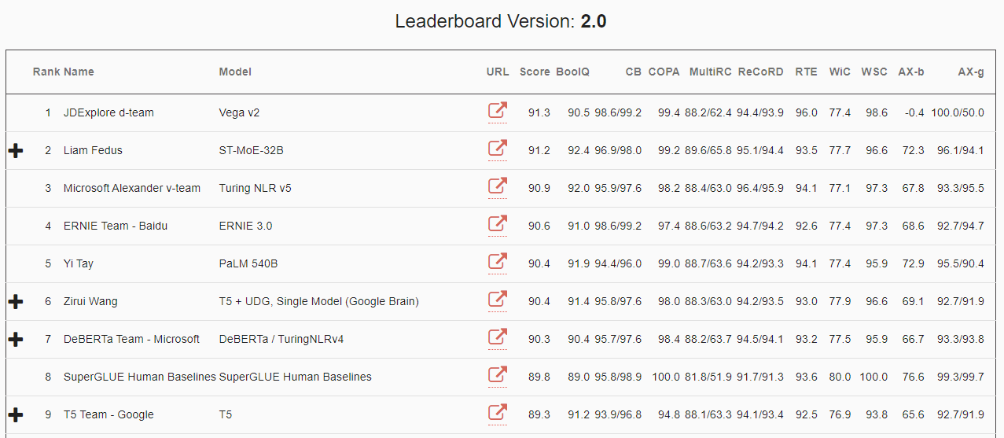
T5
Most common model is T5-11b (11 billion parameters), but smaller variants also exist
Fine-tuned T5-11b is still pretty competitive in NLP benchmarks
https://super.gluebenchmark.com/leaderboard

Slide 24
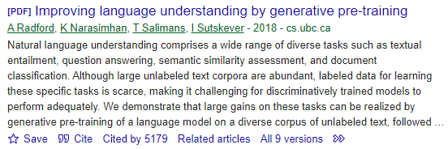
GPT-1
Precursor model to GPT-2, GPT-3, and GPT-4
Decoder-only. Does not encode entire input sequence—rather, just encodes input sequence token-by-token
Trained using standard autoregressive language modeling objective
Uses teacher forcing (I believe)
Trained on BooksCorpus dataset
12 layers, 12 heads per layer, 120M parameters

Slide 25
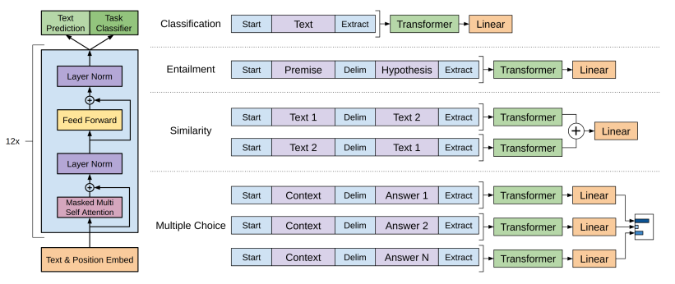
GPT-1 fine-tuning

Slide 26
GPT-2,3,4
All larger and more capable versions of GPT-1
Same model with slight modifications
Same or larger datasets
GPT-2: 1.5B parameters
GPT-3: 175B parameters
GPT-4: ???????????

Slide 27
How to choose?
For general-purpose NLP fine-tuning, use the biggest model you can train:
T5-11b → RoBERTa-Large → BERT-base → DistilBERT
For text generation, GPT-2 or GPT-Neo
For specific domains, try to find domain-specific versions of models
E.g. MatSciBERT for materials-science specific NLP tasks
Hugging Face has a nice search interface
Important to try multiple models

Slide 28
Concluding thoughts
Pretrained transformer models
BERT, RoBERTa, XLNet, RoBERTa, DistilBERT, T5, GPT-X
Encoder-decoder, encoder-only, decoder-only
How to choose?
Looking forward:
Zero- and few-shot learning
Prompt engineering

